Slide 1
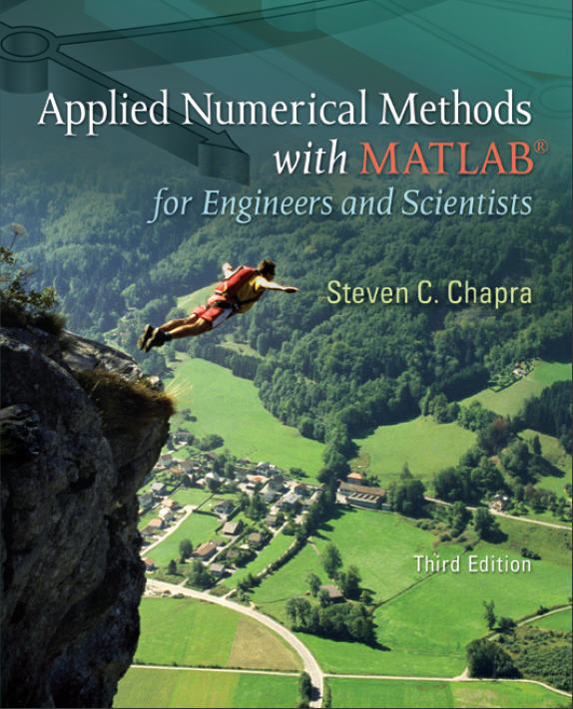
Part 5
Chapter 20
Numerical Integration of Functions
PowerPoints organized by Dr. Michael R. Gustafson II, Duke University
All images copyright © The McGraw-Hill Companies, Inc. Permission required for reproduction or display.

Slide 2
Chapter Objectives
Understanding how Richardson extrapolation provides a means to create a more accurate integral estimate by combining two less accurate estimates.
Understanding how Gauss quadrature provides superior integral estimates by picking optimal abscissas at which to evaluate the function.
Knowing how to use MATLAB’s built-in functions quad and quadl to integrate functions.

Slide 3
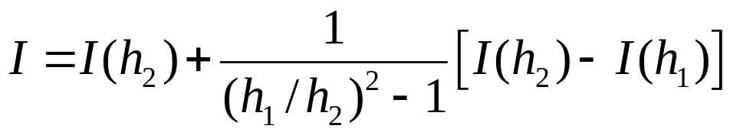
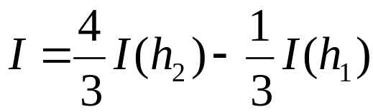
Richardson Extrapolation
Richard extrapolation methods use two estimates of an integral to compute a third, more accurate approximation.
If two O(h²) estimates I(h₁) and I(h₂) are calculated for an integral using step sizes of h₁ and h₂, respectively, an improved O(h⁴) estimate may be formed using:
For the special case where the interval is halved (h₂=h₁/2), this becomes:

Slide 4
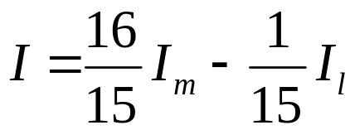
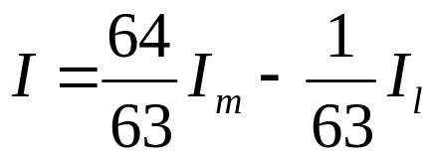
Richardson Extrapolation (cont)
For the cases where there are two O(h⁴) estimates and the interval is halved (h_{m}=h_{l}/2), an improved O(h⁶) estimate may be formed using:
For the cases where there are two O(h⁶) estimates and the interval is halved (h_{m}=h_{l}/2), an improved O(h⁸) estimate may be formed using:

Slide 5
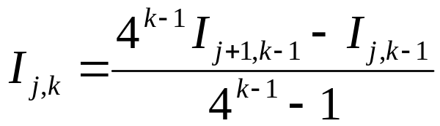
The Romberg Integration Algorithm
Note that the weighting factors for the Richardson extrapolation add up to 1 and that as accuracy increases, the approximation using the smaller step size is given greater weight.
In general,
where i_{j+1,k-1} and i_{j,k-1} are the more and less accurate integrals, respectively, and i_{j,k} is the new approximation. k is the level of integration and j is used to determine which approximation is more accurate.

Slide 6
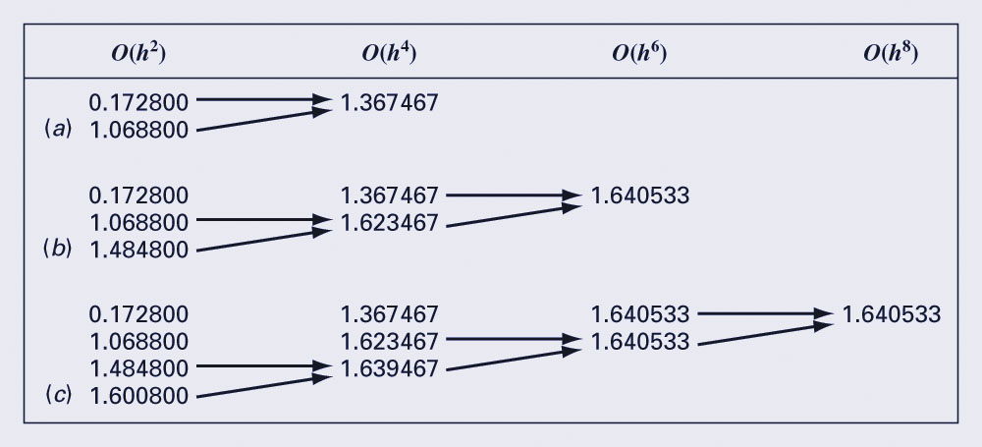
Romberg Algorithm Iterations
The chart below shows the process by which lower level integrations are combined to produce more accurate estimates:

Slide 7
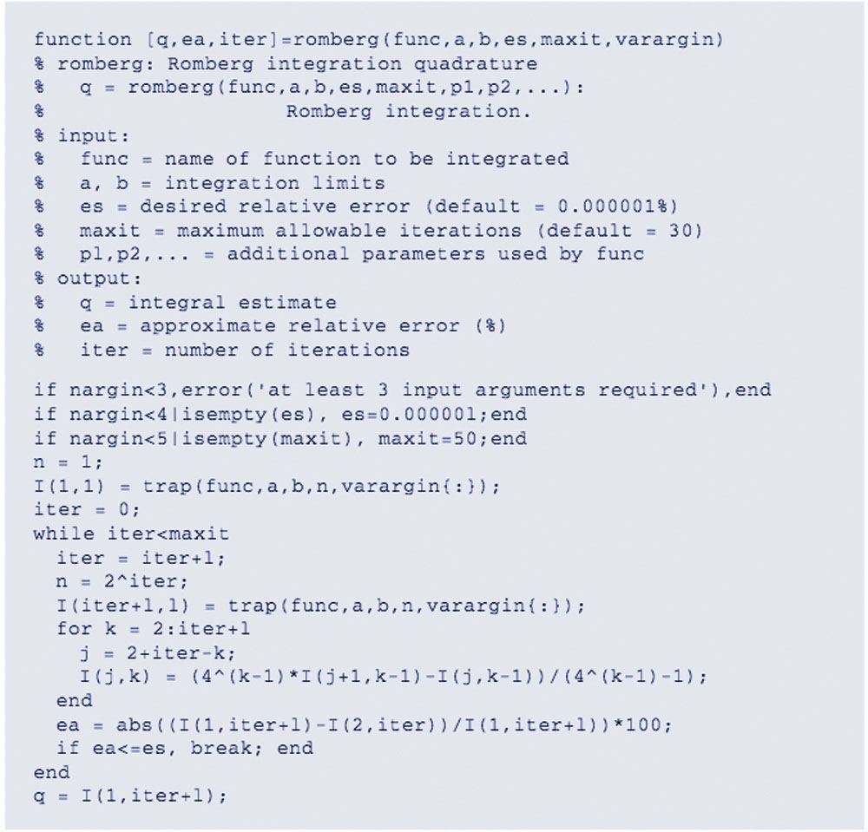
MATLAB Code for Romberg

Slide 8
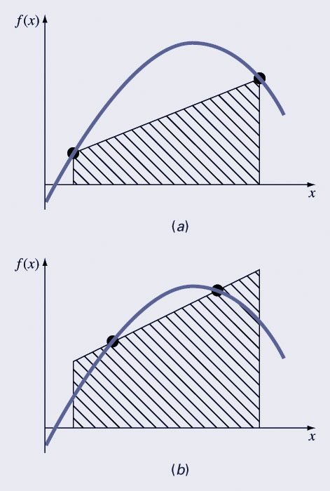
Gauss Quadrature
Gauss quadrature describes a class of techniques for evaluating the area under a straight line by joining any two points on a curve rather than simply choosing the endpoints.
The key is to choose the line that balances the positive and negative errors.

Slide 9
Gauss-Legendre Formulas
The Gauss-Legendre formulas seem to optimize estimates to integrals for functions over intervals from -1 to 1.
Integrals over other intervals require a change in variables to set the limits from -1 to 1.
The integral estimates are of the form:
where the c_{i} and x_{i} are calculated to ensure that the method exactly integrates up to (2n-1)^{th} order polynomials over the interval from -1 to 1.

Slide 10
Adaptive Quadrature
Methods such as Simpson’s 1/3 rule has a disadvantage in that it uses equally spaced points - if a function has regions of abrupt changes, small steps must be used over the entire domain to achieve a certain accuracy.
Adaptive quadrature methods for integrating functions automatically adjust the step size so that small steps are taken in regions of sharp variations and larger steps are taken where the function changes gradually.

Slide 11
Adaptive Quadrature in MATLAB
MATLAB has two built-in functions for implementing adaptive quadrature:
  quad: uses adaptive Simpson quadrature; possibly more efficient for low accuracies or nonsmooth functions
  quadl: uses Lobatto quadrature; possibly more efficient for high accuracies and smooth functions
q = quad(fun, a, b, tol, trace, p1, p2, …)
  fun : function to be integrates
  a, b: integration bounds
  tol: desired absolute tolerance (default: 10-6)
  trace: flag to display details or not
  p1, p2, …: extra parameters for fun
  quadl has the same arguments

